Slide 1
Version Routines
September 2011
Notes:
© 2006 Capgemini - All rights reserved
0

Slide 2
Objectives
Why Version Routines
Various Types of Version Routines
Steps to create Version Routines & Error Shots

Slide 3
Why Version Routines?
For Additional Validations During
Generation of ID
Record Level
Field Level
Commit level
Authorization level
For Defaulting Values

Slide 4
Common Variables
ID.NEW
ID.OLD
ID.NEW.LAST
R.NEW
R.OLD
R.NEW.LAST
Available in I_COMMON
Notes:
Common Variables are those variable which are similar to global variable in DOS environment.

Slide 5
ID.NEW
Common variable defined in I_COMMON
Dynamic array
Contains the ID of the currently opened record
When record is closed/committed/authorised value is flushed

Slide 6
R.NEW
Common variable defined in I_COMMON
Dimensioned array
Contains 500 dynamic arrays
Holds the currently opened record
‘R’ in the variable name stands for ‘Record’

Slide 7
R.NEW
Definition in I_COMMON : DIM R.NEW(C$SYSDIM)
C$SYSDIM = 500
No application in T24 has more than 500 fields

Slide 8
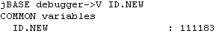
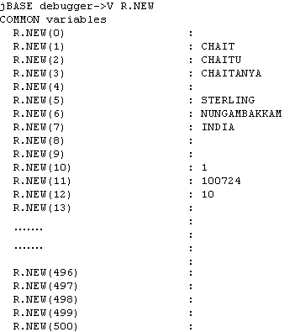
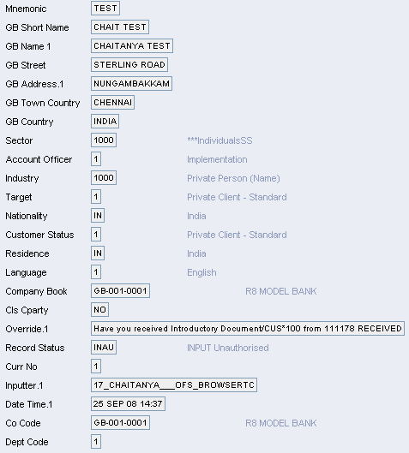
ID.NEW and R.NEW
ID.NEW
R.NEW
Notes:
For example when a user creates a new CUSTOMER record, the variables ID.NEW and R.NEW will hold the ID and the actual record respectively. Once the record is committed, data is flushed from the variables ID.NEW and R.NEW.
PRG5.BasicVersionRoutines – R11

Slide 9
ID.NEW.LAST
Defined in I_COMMON
Dynamic array
For unauthorized record - ID of the unauthorized record is held

Slide 10
R.NEW.LAST
Defined in I_COMMON
Dimensioned array
Consists of 500 dynamic arrays
Holds the currently opened record (If the record is unauthorized)
Definition in I_COMMON
DIM R.NEW.LAST(C$SYSDIM)

Slide 11
ID.NEW.LAST and R.NEW.LAST
ID.NEW
ID.NEW.LAST
R.NEW
R.NEW.LAST
Notes:
If the user opens the CUSTOMER record 111178 in authorization mode, R.NEW will hold the actual record opened and R.NEW.LAST will hold the unauthorized record pertaining to the currently opened record. In this particular example, both these variables will hold the copy of the same record. When the record is authorized, data is flushed from the variables ID.NEW , R.NEW, ID.NEW.LAST and R.NEW.LAST. Values from R.NEW only are written into the database when record is authorized.
PRG5.BasicVersionRoutines – R11

Slide 12
ID.OLD
Defined in I_COMMON
Dynamic array
For authorized record
Holds the ID of the authorized record
Enables to check if the current record is authorized

Slide 13
R.OLD
Defined in I_COMMON
Dimensioned array
Consists of 500 dynamic arrays
Holds the current authorized record (if any)
Holds the actual live record (If it exists)
Definition in I_COMMON
DIM R.OLD(C$SYSDIM)

Slide 14
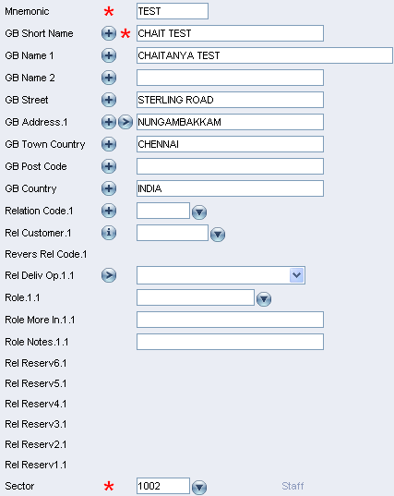
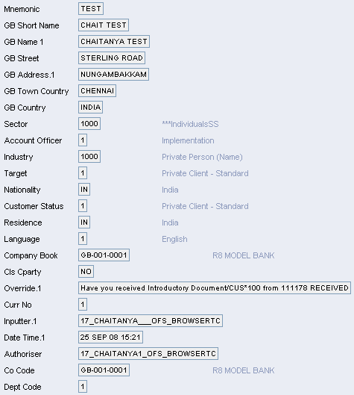
ID.OLD and R.OLD
ID.NEW
ID.NEW.LAST
ID.OLD
R.NEW
R.NEW.LAST
R.OLD
Notes:
When the user amends the authorized CUSTOMER record 111178, by changing the SECTOR field, R.OLD will have the old authorized record where as R.NEW will hold the amended customer record. Any changes are only reflected in R.NEW. When the record is committed, data is flushed from the variables ID.NEW , R.NEW, ID.OLD and R.OLD.
PRG5.BasicVersionRoutines – R11

Slide 15
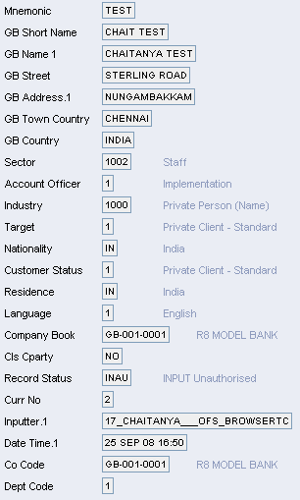
ID.NEW, R.NEW, ID.NEW.LAST, R.NEW.LAST, ID.OLD and R.OLD
ID.NEW
ID.NEW.LAST
ID.OLD
R.NEW
R.NEW.LAST
R.OLD
Notes:
If the user open existing INAU record 11178 which has a previously authorized record, in authorization mode, then R.NEW will hold the currently opened record, R.NEW.LAST will hold the last saved unauthorized copy of the record and R.OLD will hold the last authorized copy. Once the record is authorized, data is flushed from all the variables. Values from R.NEW only are written into the database when record is authorized. The old authorized record R.OLD with SECTOR 1000 is moved to history file with the ID as 111178;1.
PRG5.BasicVersionRoutines – R11

Slide 16
COMI
Global variable
Defined in I_COMMON file
Contains the last entered value in any application/version

Slide 17
Types of Version Routines
Validation Routine
Input Routine
Authorization Routine
Auto Field Routine
Id Routine
After unauth Routine
Before Auth Routine

Slide 18
Validation Routine
Why Validation routine?
When Validation Routine is called?
Where do we Attach the routine?
Mandatory Prerequisites.
How to Create Version Routines – Scenario.

Slide 19
Why validation routine?
To perform Field level validations.
To perform validation as soon as the data entered.

Slide 20
When Validation Routine is called?
In the version to which we attach the routine
When the users comes out of the field for which we have validated

Slide 21
Where do we Attach the routine?
Attached to the specific field of the version.
Field to be validated is specified in Validation.Fld
Routine used to validate is specified in Validation.Rtn

Slide 22
Mandatory - Prerequisites
Entry in PGM.FILE
Entry in EB.API

Slide 23
Scenario
Create a version for FUNDS.TRANSFER with the mandatory fields
Write a Validation Routine to restrict the funds transfer for amount more than 1000/-.

Slide 24
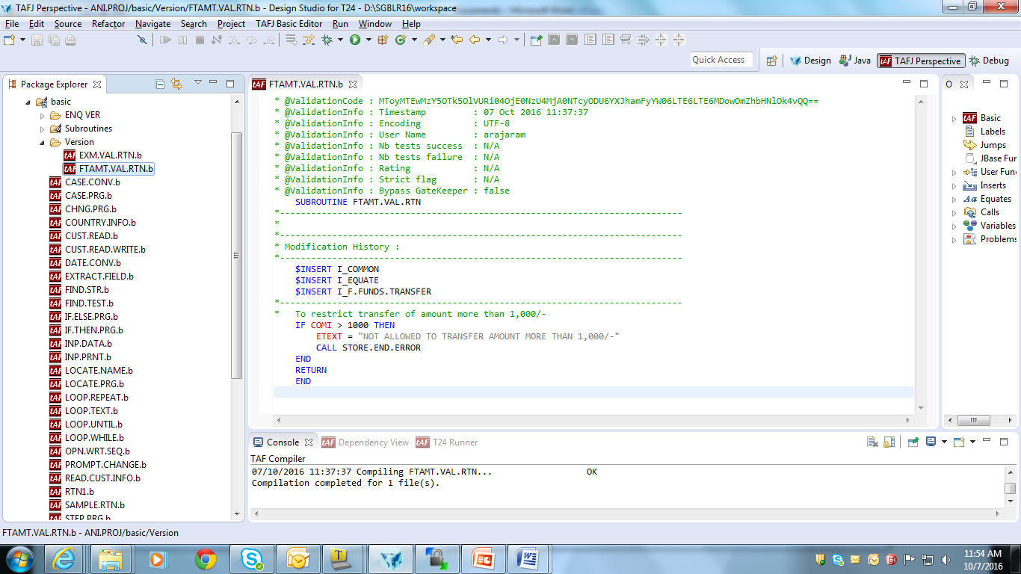
Write the Validation Routine

Slide 25
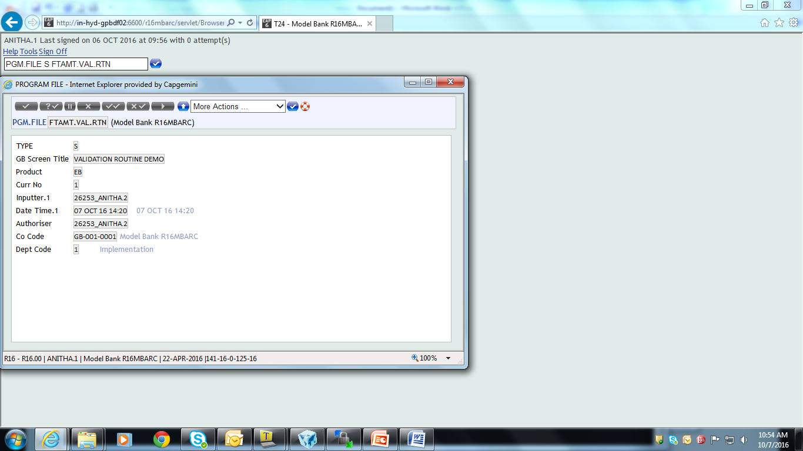
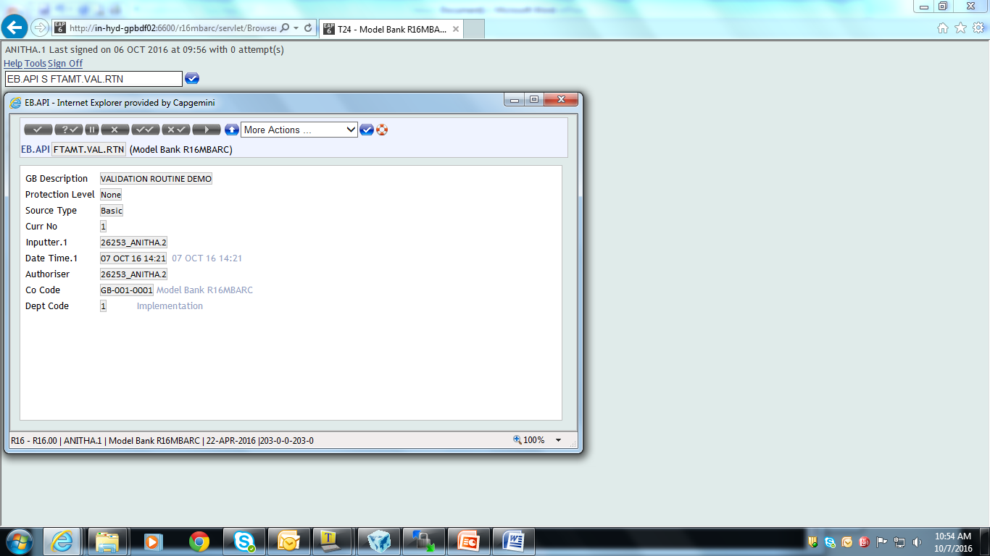
PGM.FILE and EB.API

Slide 26
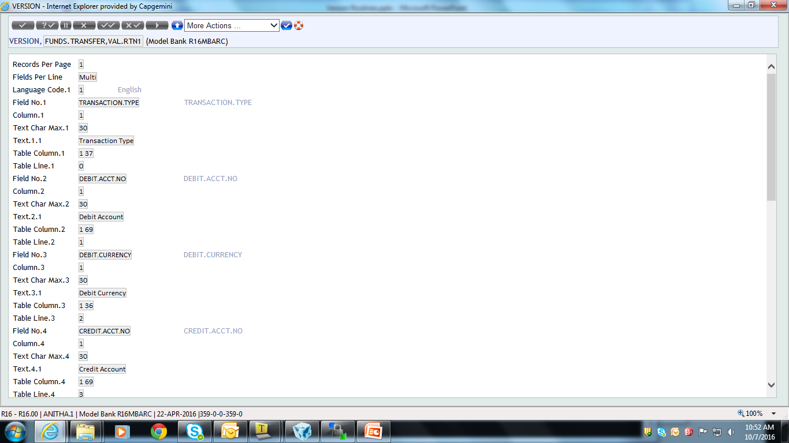
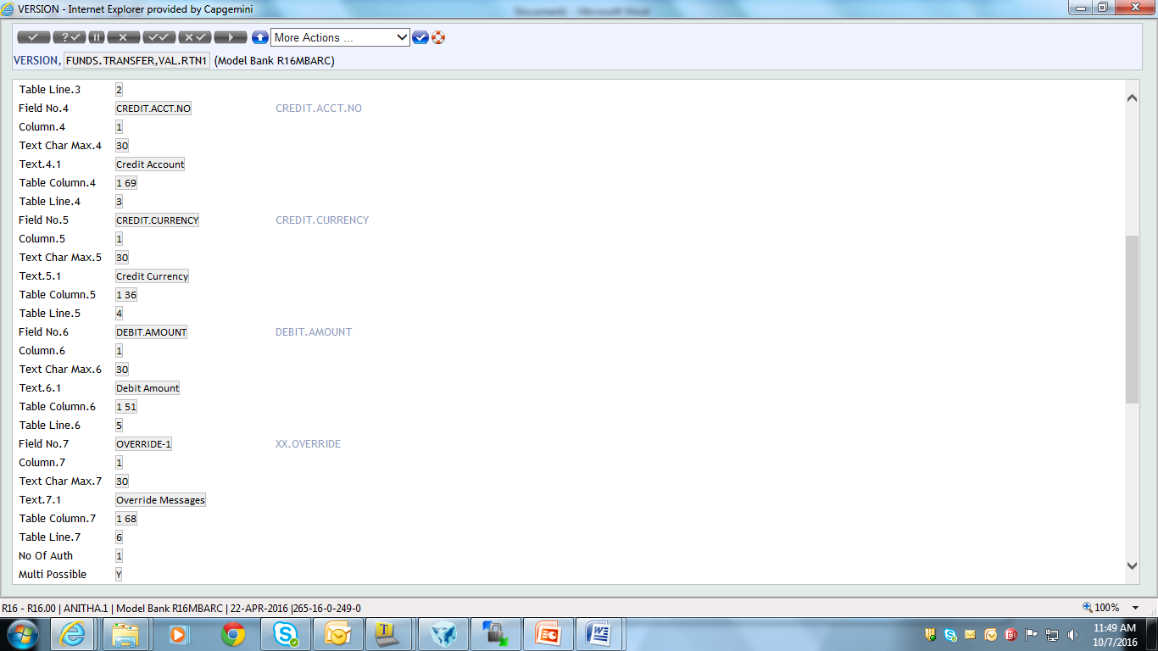
Create the Version

Slide 27
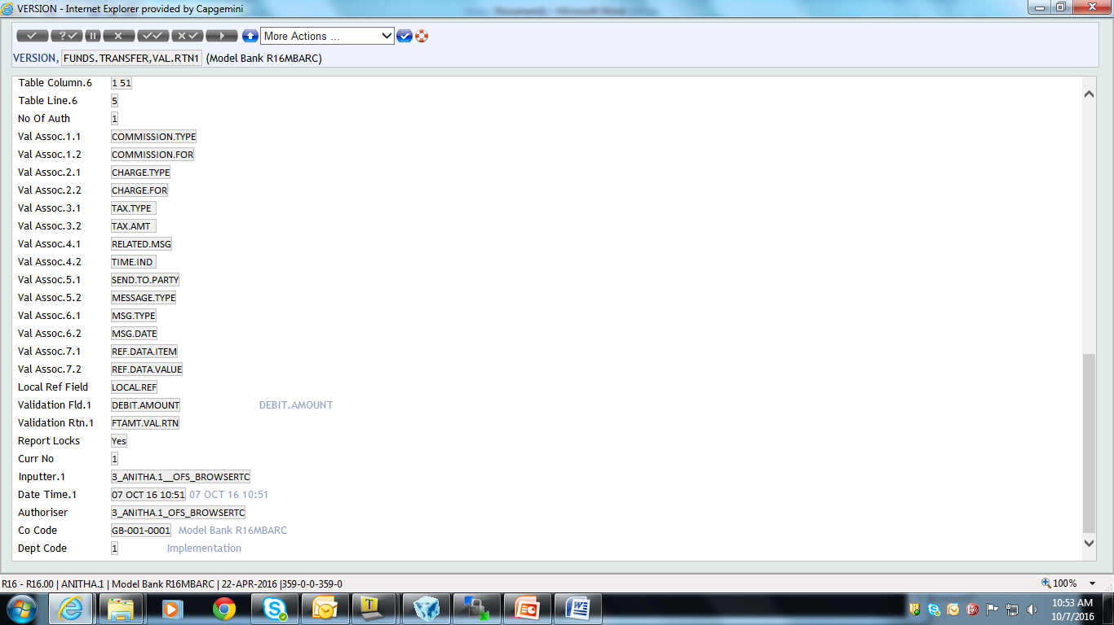
Attaching the routine to the version

Slide 28
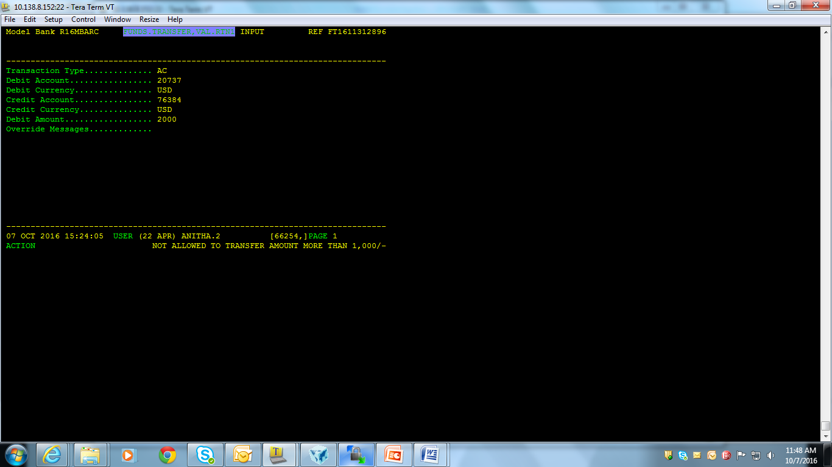
Run the Version
Enter the value in Debit Amount field GT 1000
Validation Routine is called only on validation

Slide 29
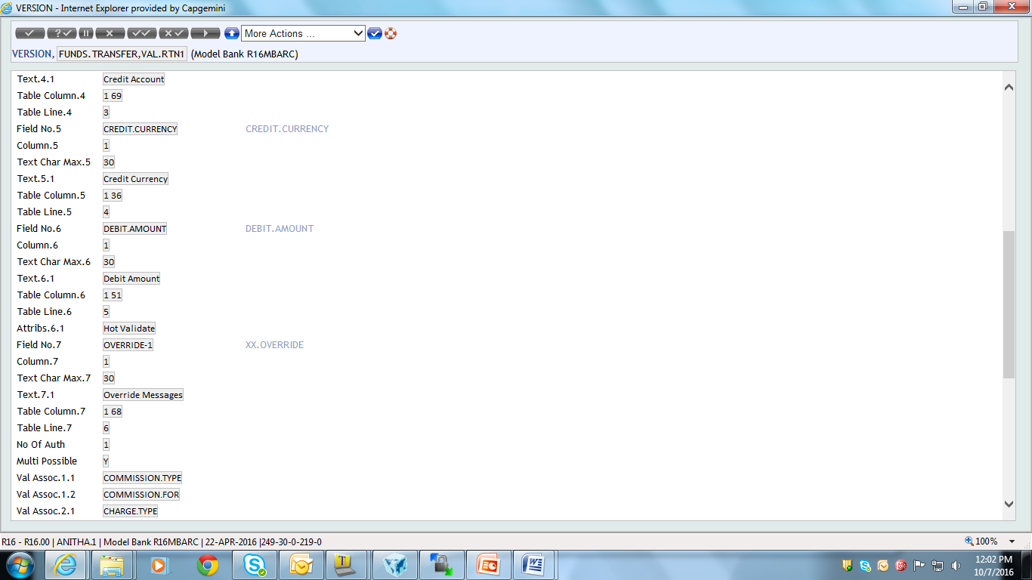
Set the Attribute

Slide 30
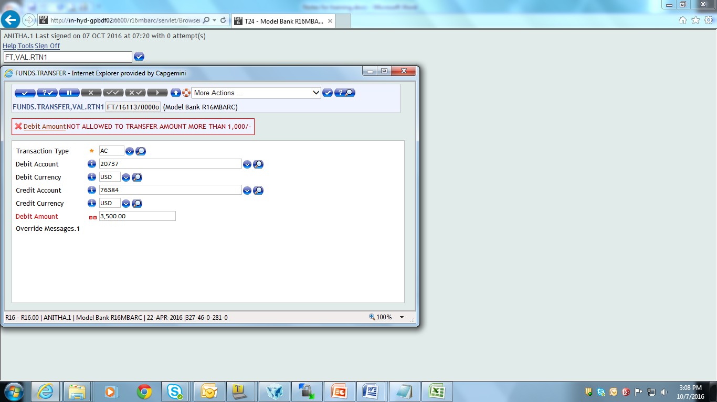
Run the Application
Attribute is set to DEBIT.AMOUNT as HOT.VALIDATE
Routine called immediately after exit from DEBIT.AMOUNT
Thus becomes field level Validation
Hot Validate
Notes:
Steps for executing the routines from Browser:
1) Right click on the project and go to Properties>TAFJ>Compiler and tick the check box 'Generate jar after compile' and click 'Apply'.
2) Write the routine and compile it in design studio.
3) Jar file will be created for the compiled folder in the following path - D:\SGBLR16\TAFJ\data\tafj\jars.
4) Rename the jar file with a required name.
5) Place the renamed jar file in the following path - \\10.109.32.157\jboss-eap-6.4_r16mbarc\modules\com\temenos\t24\main.
6) Under the same path, edit the file 'module.xml' and add the following line to the file - <resource-root path="Version.jar" /> and save it.
7) Restart the browser.

Slide 31
HOT.FIELDS Vs HOT.VALIDATE
In browser field level validations are done when field is
HOT.FIELD
HOT.VALIDATE
Hot fields can be used to default other field values
Hot validate can be used for validation only

Slide 32
Hot Field Example
Create a Version for FUNDS.TRANSFER with the required fields
Make DEBIT.AMOUNT as hot field. On coming out of DEBIT.ACCT.NO the ‘PAYMENT.DETAILS’ field should be updated as
<CUS>_<Number of Accounts>

Slide 33
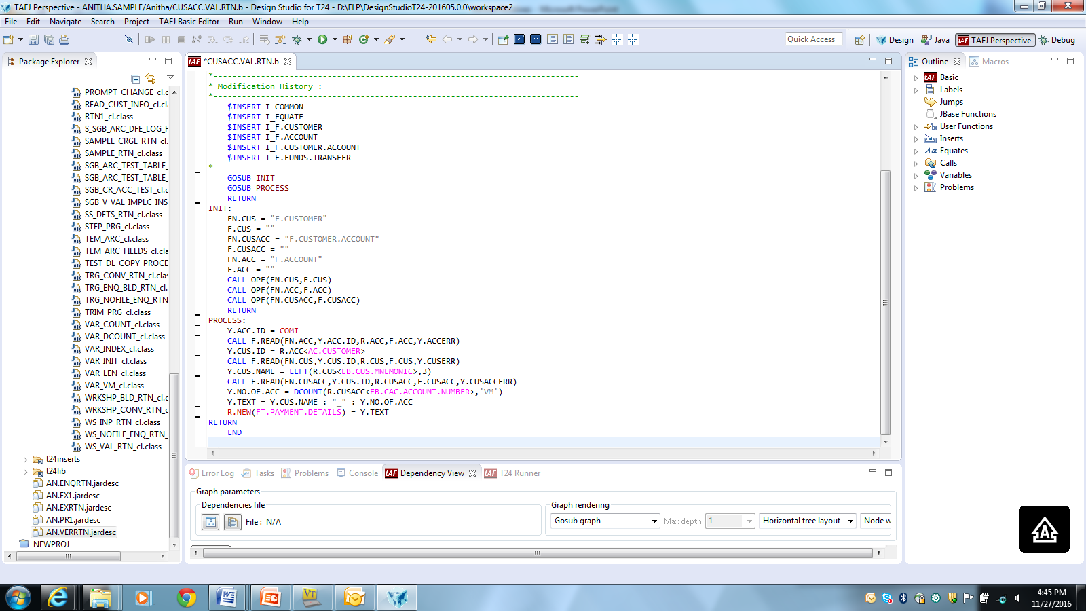
Solution

Slide 34
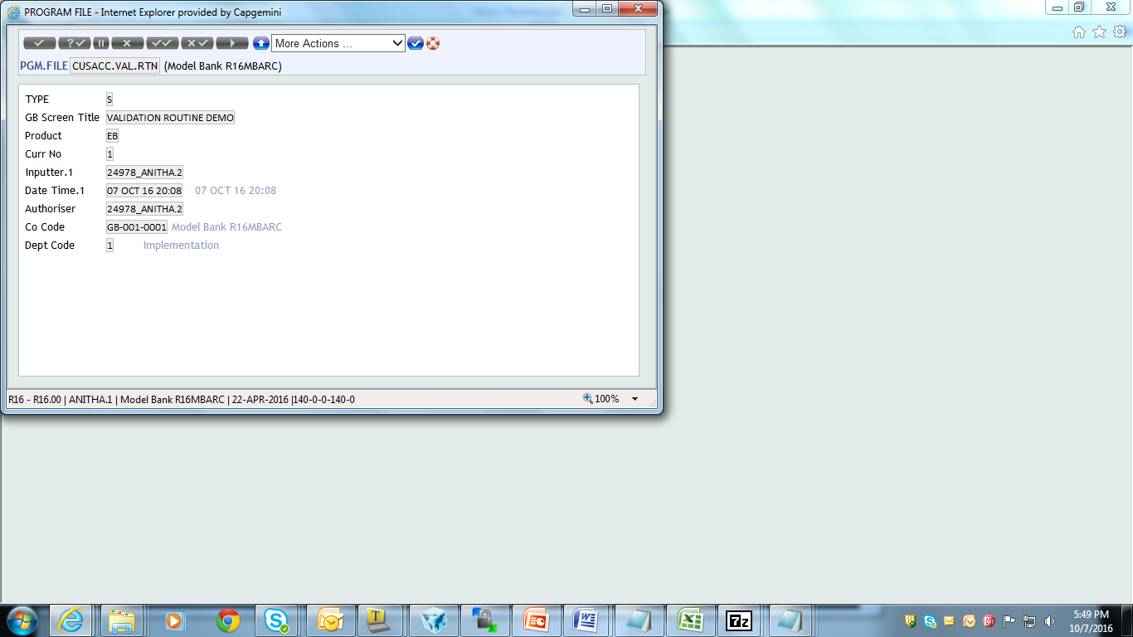

PGM.FILE and EB.API

Slide 35
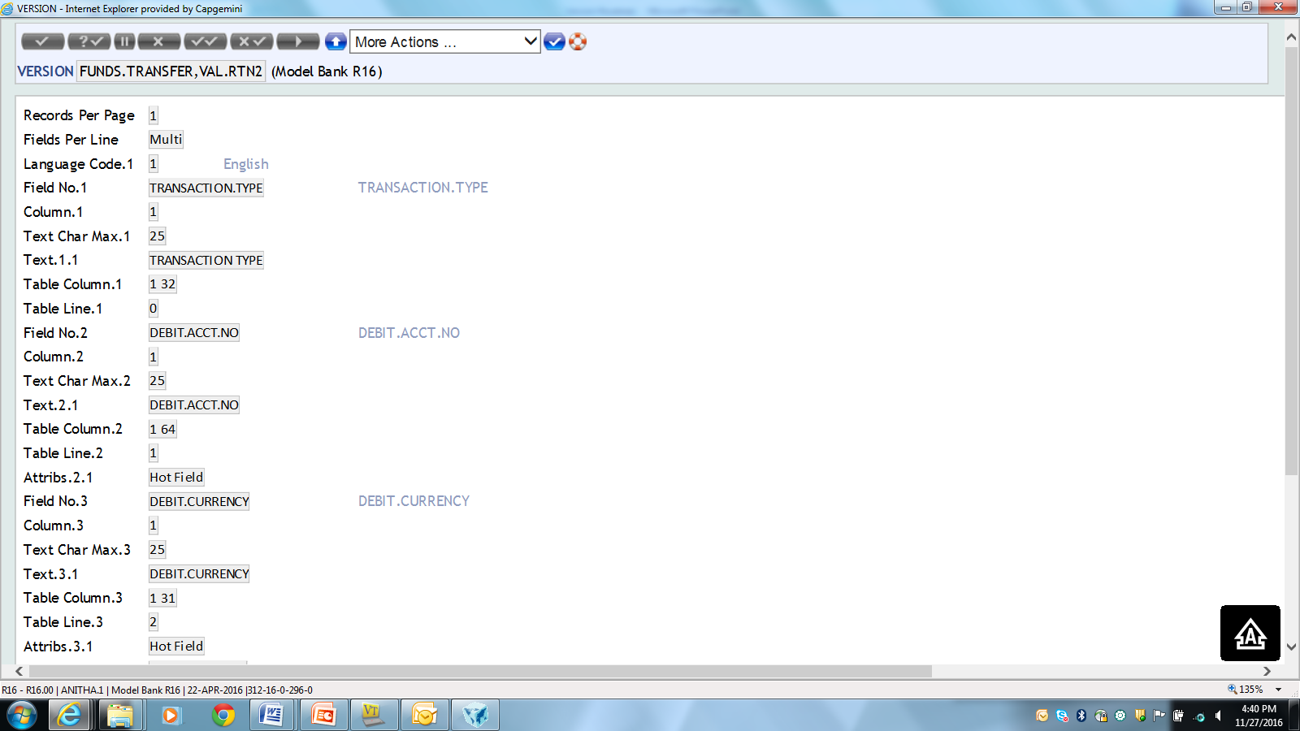
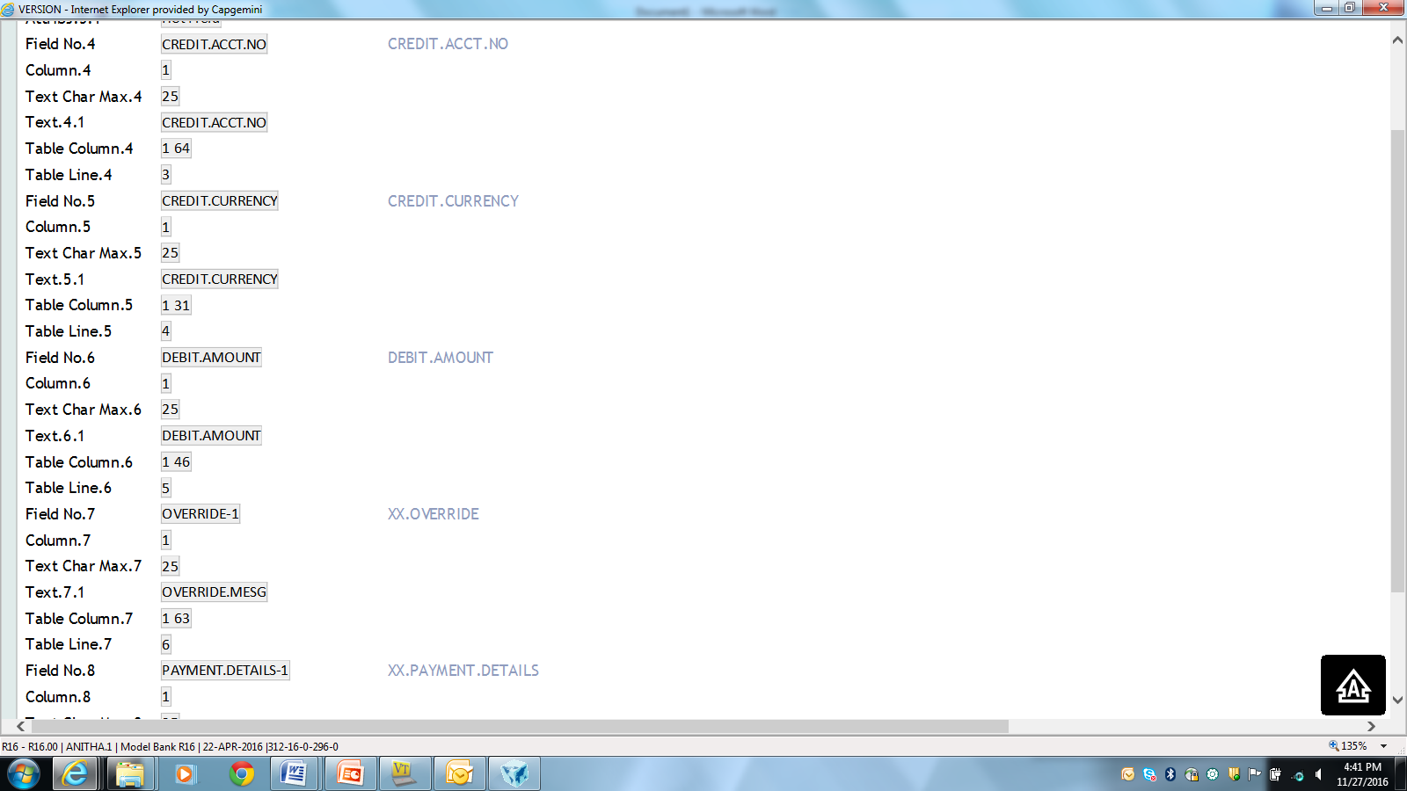
Create version

Slide 36
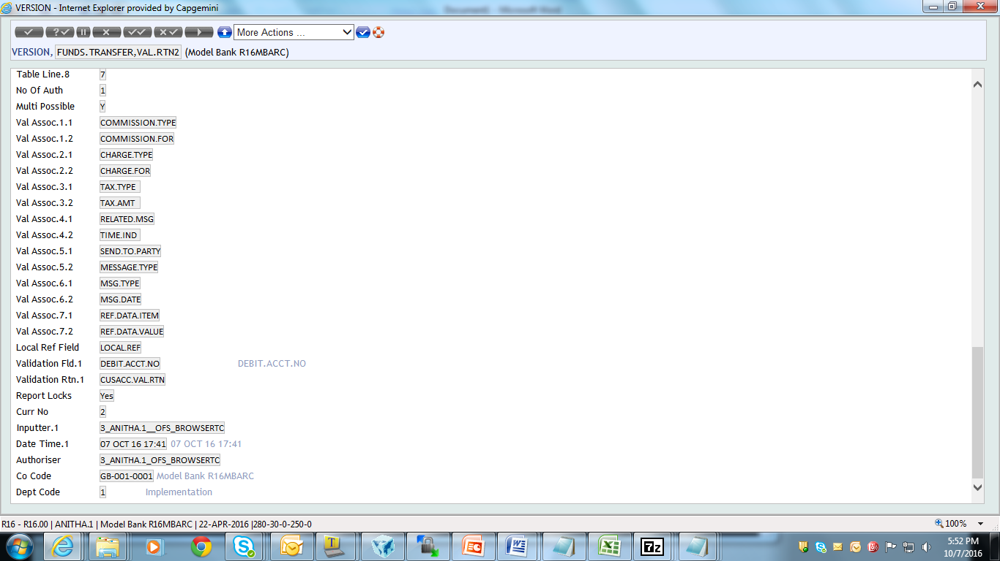
Create version

Slide 37
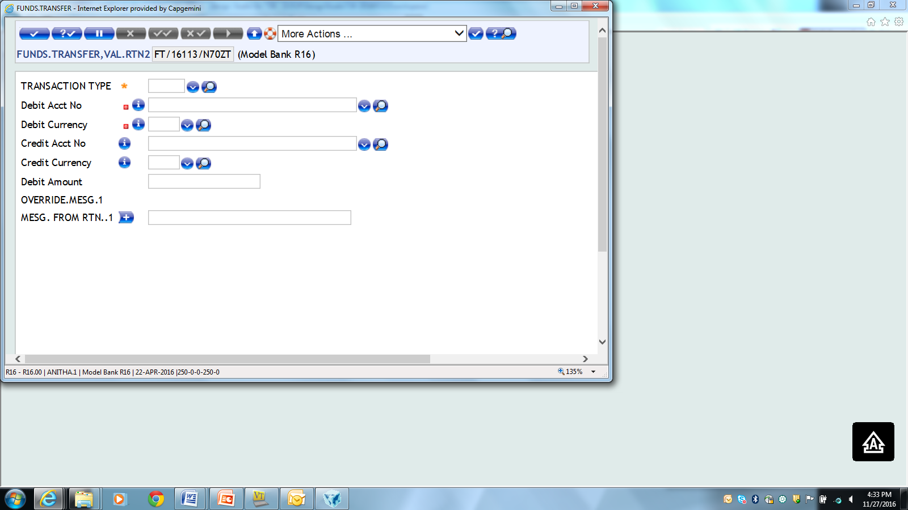
Run the Version
Hot Field

Slide 38
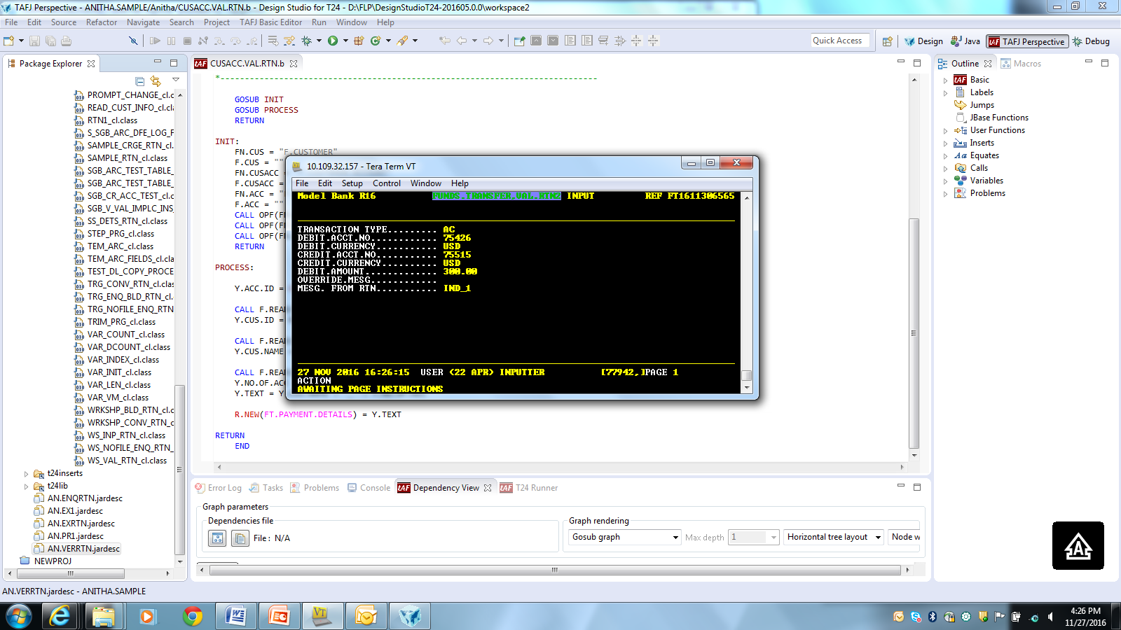
Run the Version

Slide 39
Scenario
Create a version for the FUNDS TRANSFER application with the following fields
Transaction Type
Debit Account Number
Debit Currency
Debit Amount
Debit Value Date
Credit Account Number
Credit Currency

Slide 40
Scenario
As soon as the Debit account number is entered, Validation Routine should check whether it is a savings account otherwise it should throw an error “DEBIT ACCOUNT IS NOT A SAVINGS ACCOUNT’

Slide 41
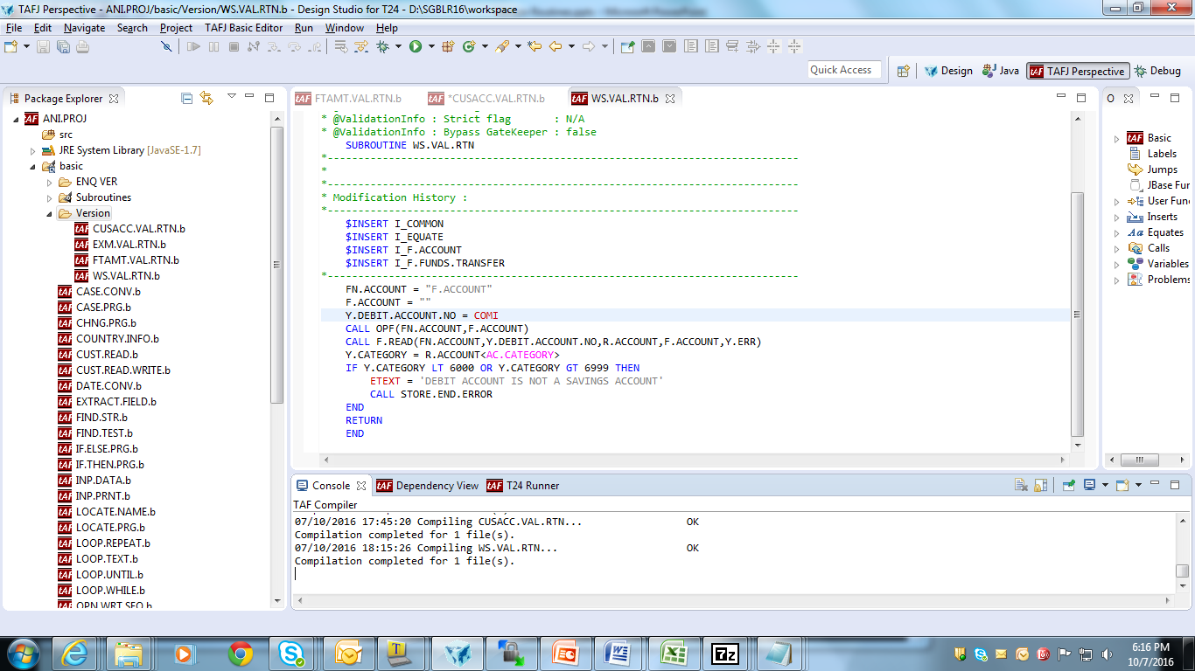
Routine

Slide 42
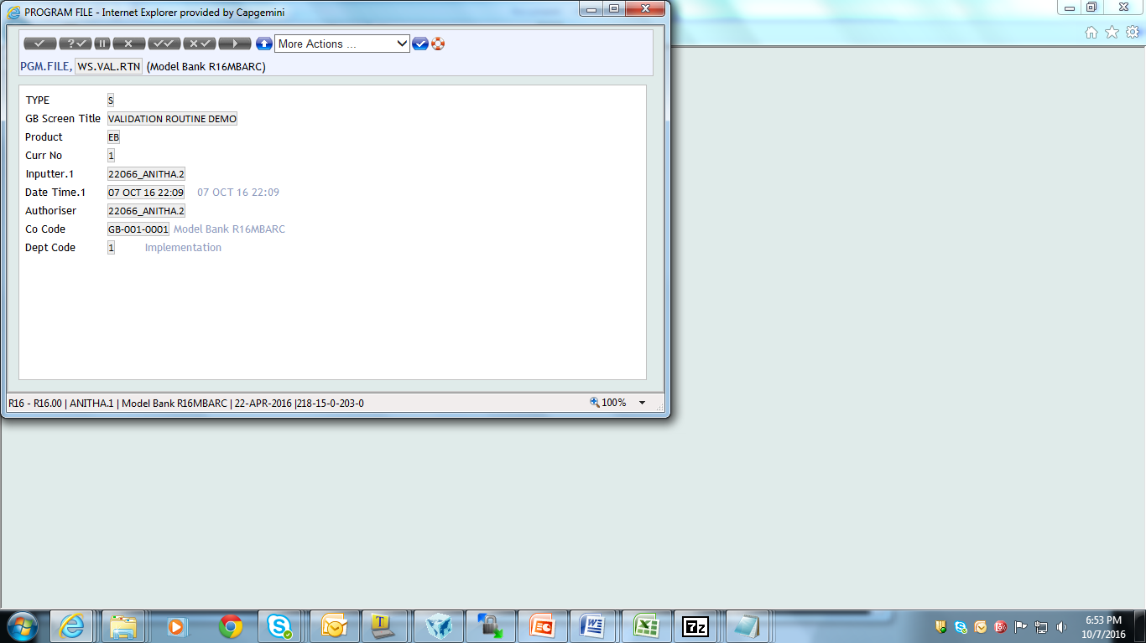
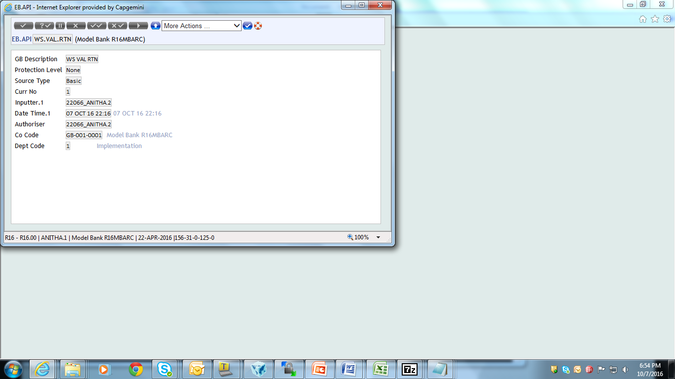
PGM.FILE and EB.API

Slide 43
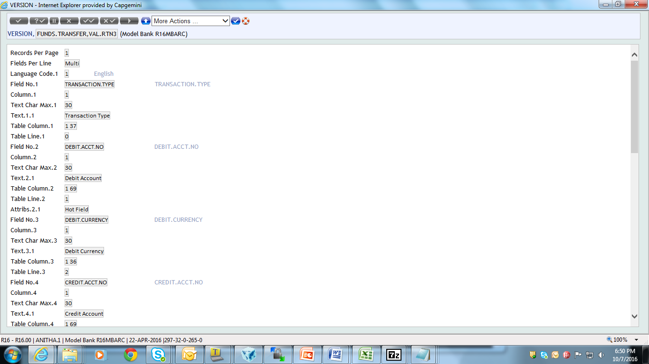
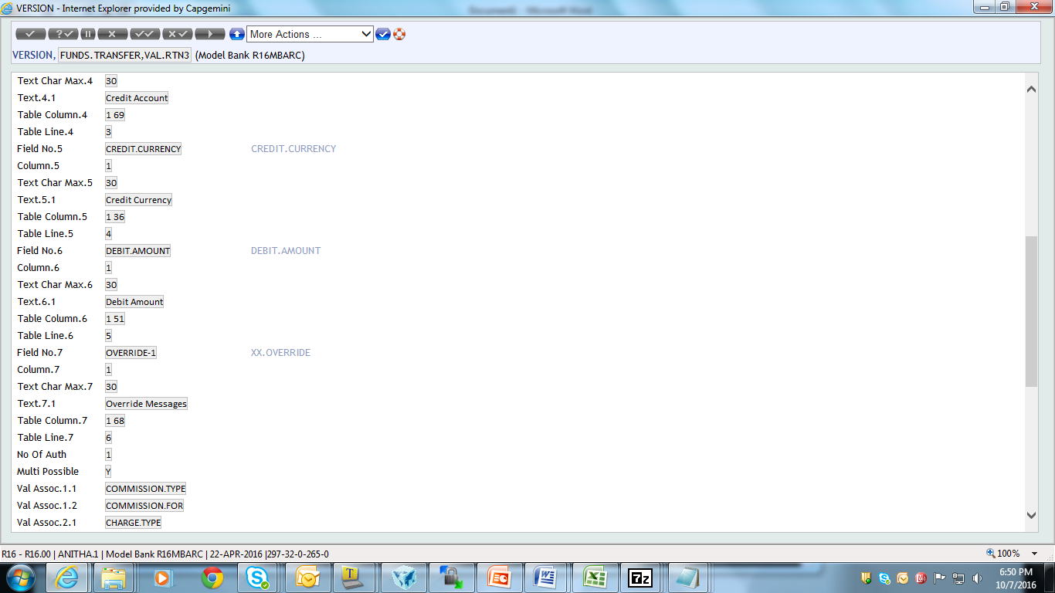
Version

Slide 44

Version

Slide 45
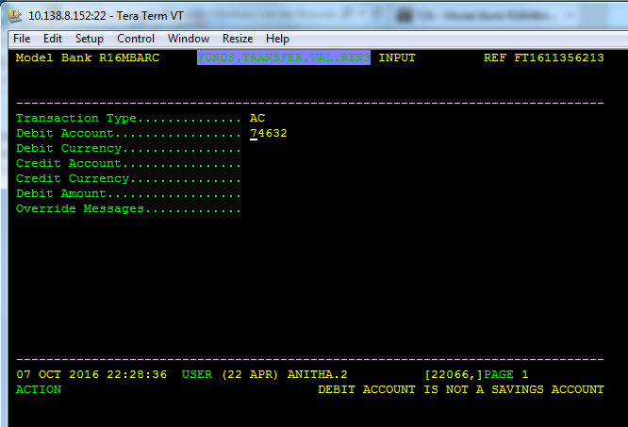
Output

Slide 46
Workshop 2
Create a version in FT with mandatory fields if the debit amount is greater than working balance then display error Message.

Slide 47
Input Routines
Why Input routine?
When Input Routine is called?
Where do we Attach the routine?
Mandatory Prerequisites.
How to Create Input Routines – Scenario.

Slide 48
Why Input Routines
Update local files
Provide additional validation at input stage
Provide override processing

Slide 49
When do Input Routines Called
Gets invoked when committing a transaction
All validations might have been completed

Slide 50
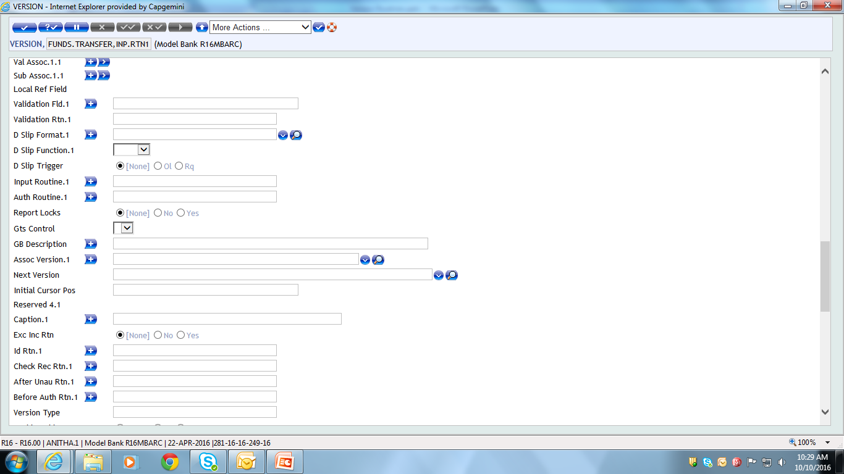
Where do we attach Input Routine

Slide 51
Mandatory - Prerequisites
Entry in PGM.FILE
Entry in EB.API

Slide 52
Scenario
Create a Version for Funds Transfer version with the mandatory field. Write an Input routine to check if the CREDIT CURRENCY and the DEBIT CURRENCY match. If not an error message, “Credit and Debit currency mismatch” needs to be displayed when the user commits the record.

Slide 53
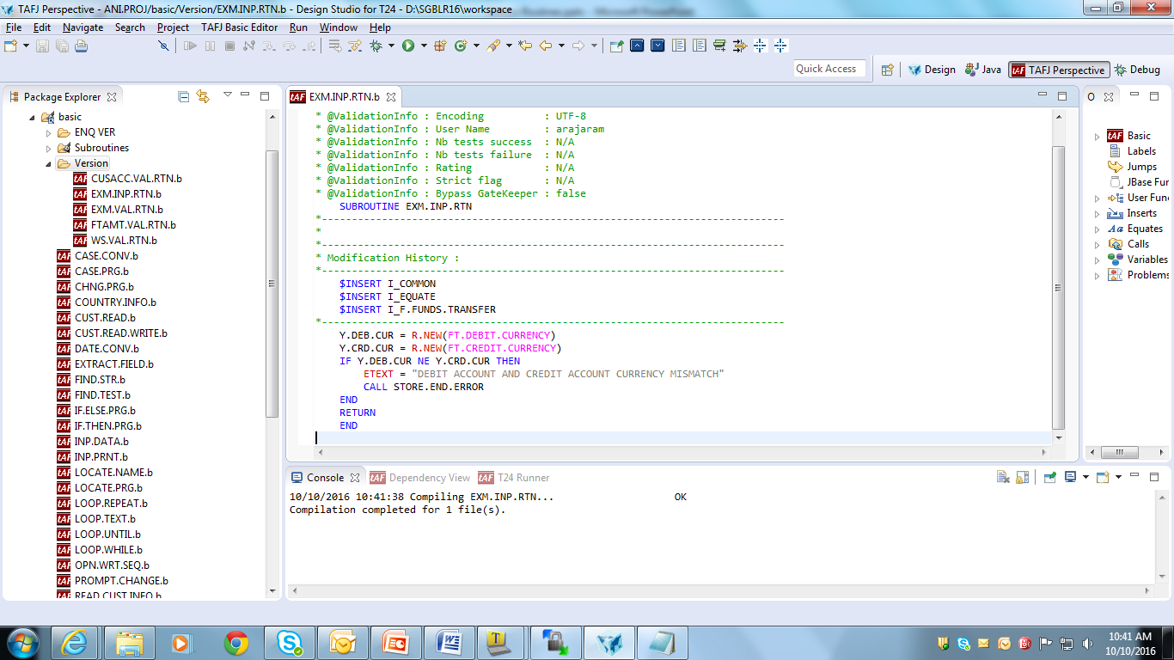
Routine

Slide 54
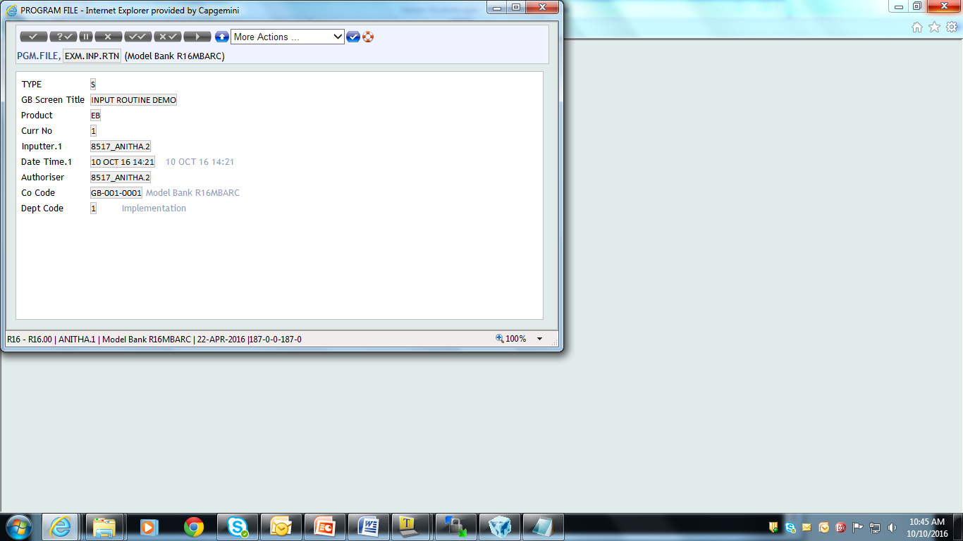
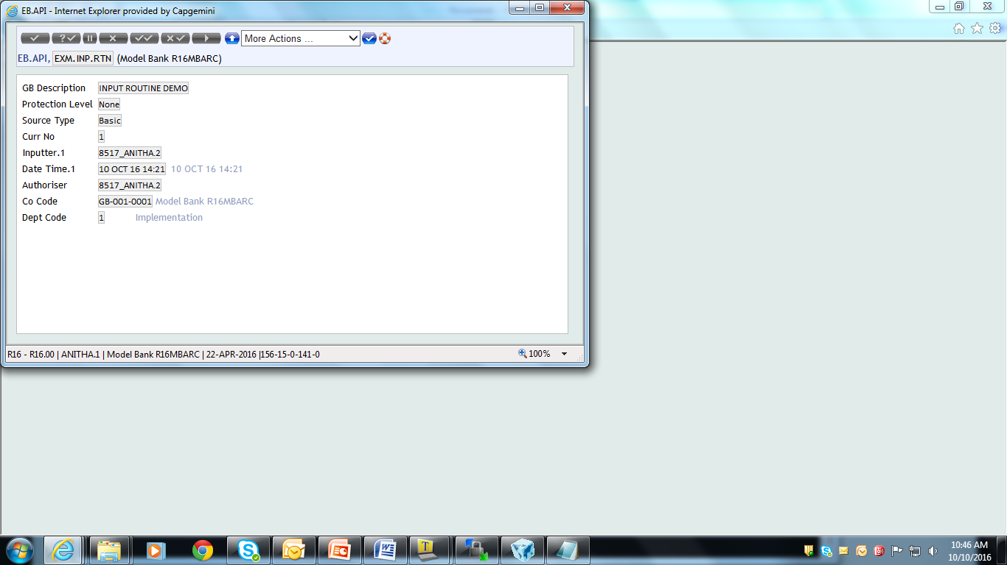
PGM.FILE and EB.API

Slide 55
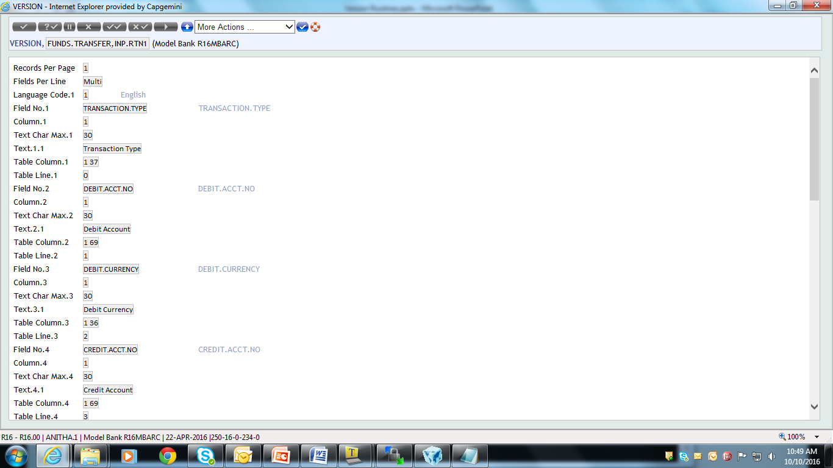
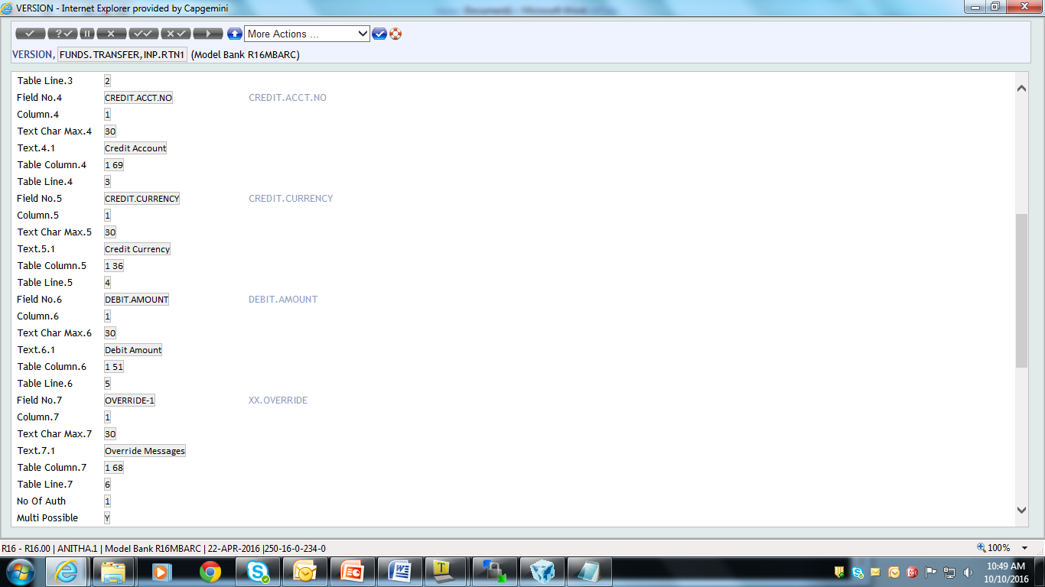
Create Version

Slide 56
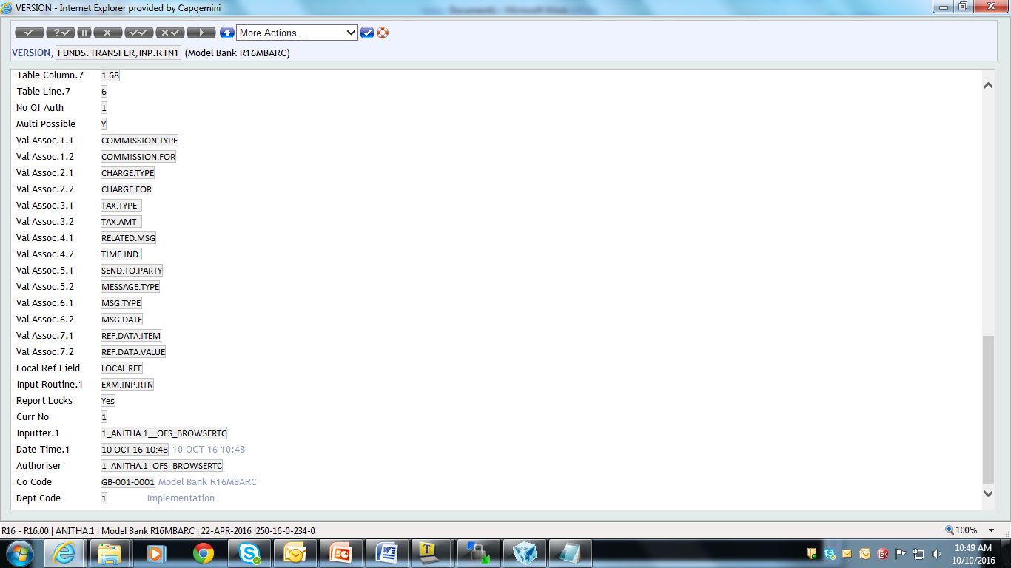
Attach the routine to the version

Slide 57
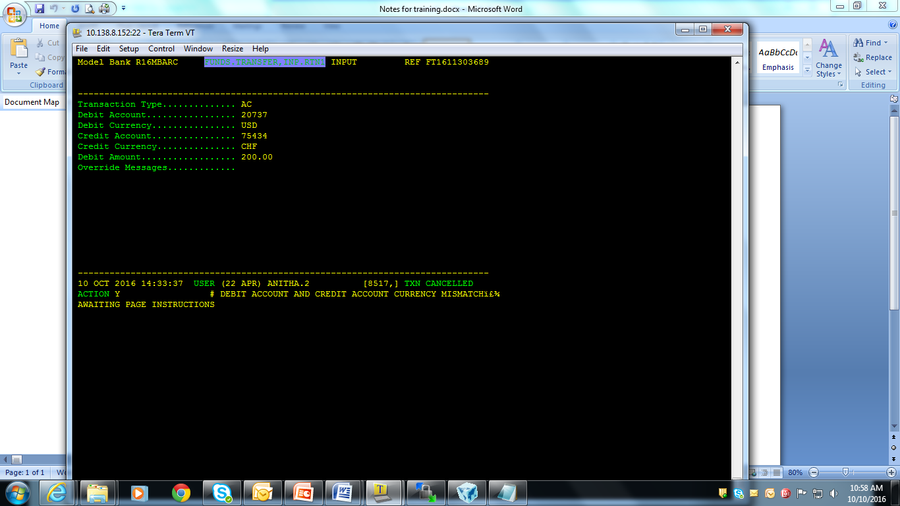
Commit

Slide 58
Workshop 1
Create a version for FUNDS.TRANSFER with mandatory fields and the following validations done in input routine
Account should be savings
Customer should be an individual

Slide 59
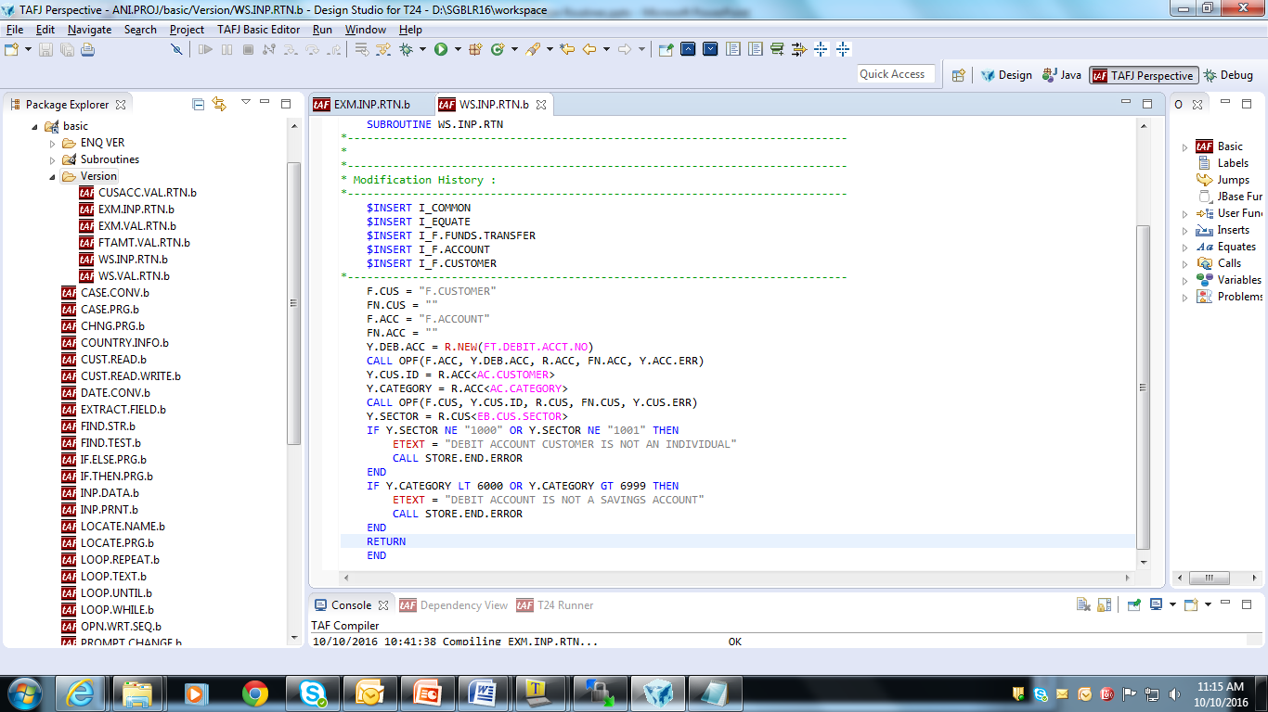
Routine

Slide 60
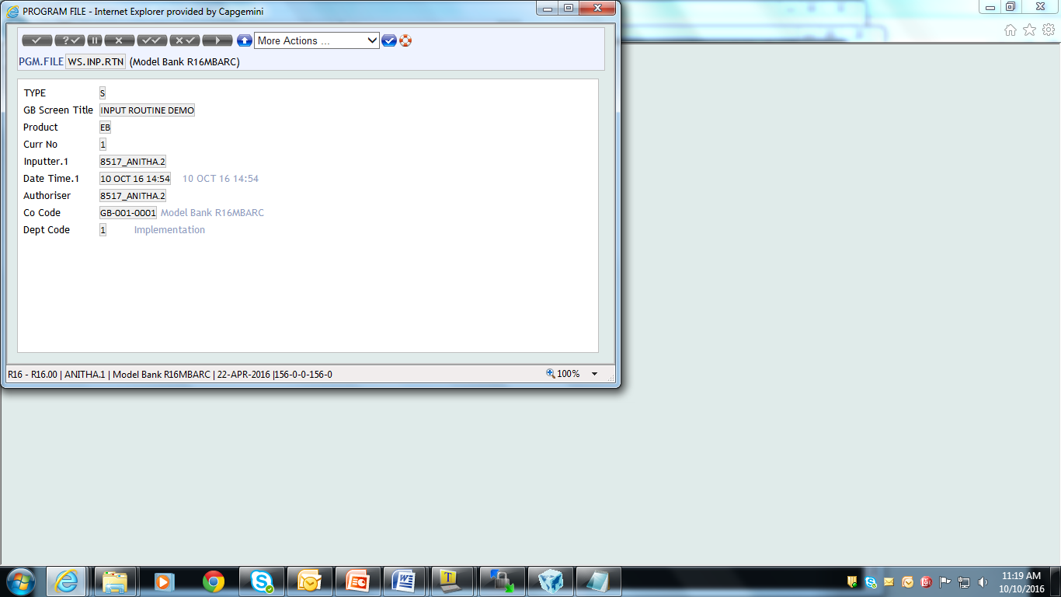
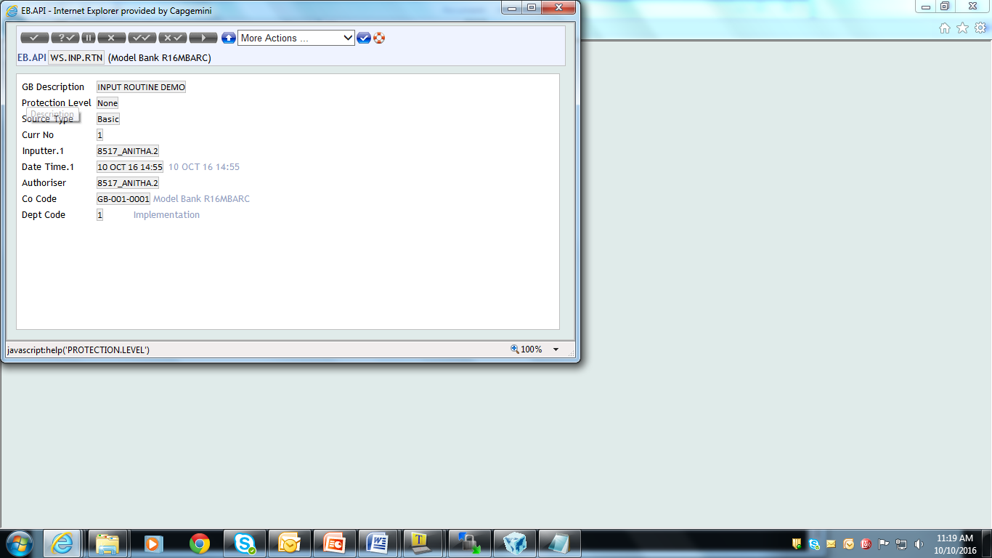
PGM.FILE and EB.API

Slide 61


Version

Slide 62

Attach the routine to the Version

Slide 63

Output

Slide 64
Authorisation Routine
Why Authorisation routine?
When Authorisation Routine is called?
Where do we Attach the routine?
Mandatory Prerequisites.
How to Create Authorisation Routines – Scenario.

Slide 65
Why Authorisation routine
To update local files
To provide additional validation at authorization stage
To provide override processing

Slide 66
When Authorisation Routine is Called
Time of Authorisation of Transaction
After Field level validations.
After standard default processing is done.

Slide 67
Where do we attach the Routine

Slide 68
How to create Authorisation Routines - Scenario
Once a record in a version of the FUNDS.TRANSFER application is authorised, details from the transaction need to be extracted and written on to a flat file named TRG.FT.DATA for interface purposes.
ID of the record in the flat file needs to be the FT id
Following field’s values need to be stored in the flat file all delimited with a single space
Credit Account Number
Debit Account Number
Value Date
Debit Amount
Debit Currency

Slide 69
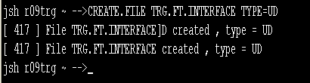
Solution
Creates a Sequential File
File created for updation

Slide 70
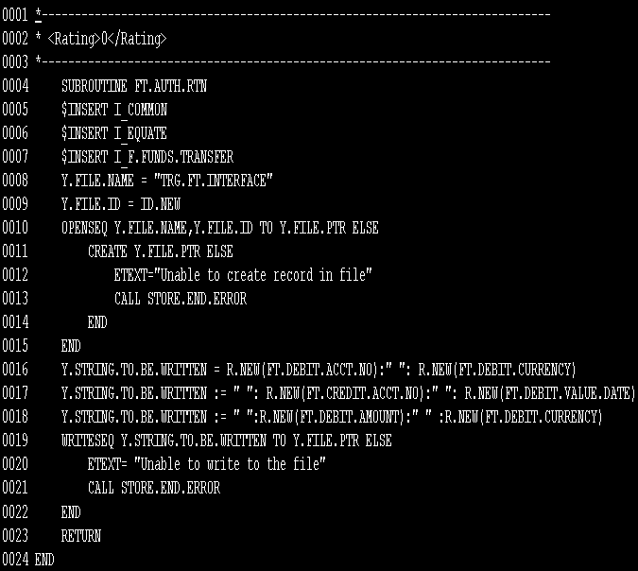
Routine

Slide 71
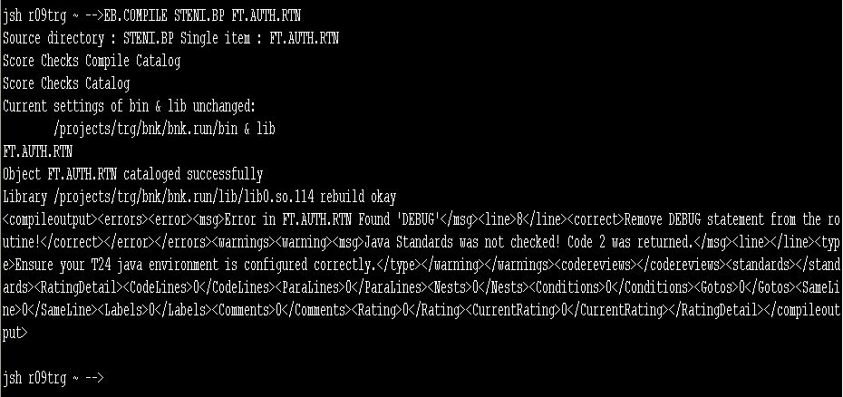
Compile and Catalogue

Slide 72
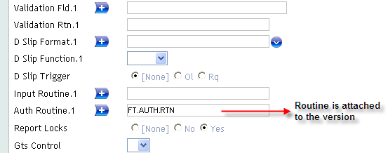
Create the Version

Slide 73
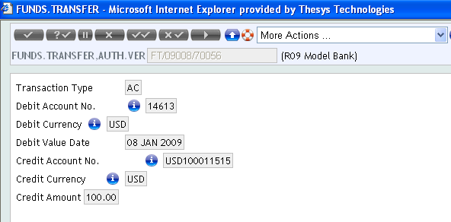
Commit the Version

Slide 74
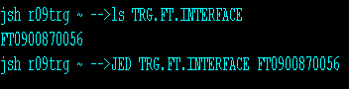
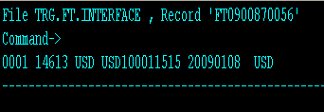
Value in TRG.FT.INTERFACE

Slide 75
Workshop 1
Create version for Account application and input a record using the version.
When the record is authorised using the version it has to check for
If the Currency is USD or GBP then Nationality or residence of the customer should be US
Else it should display a error message “WRONG CURRENCY ENTERED FOR THIS CUSTOMER”

Slide 76
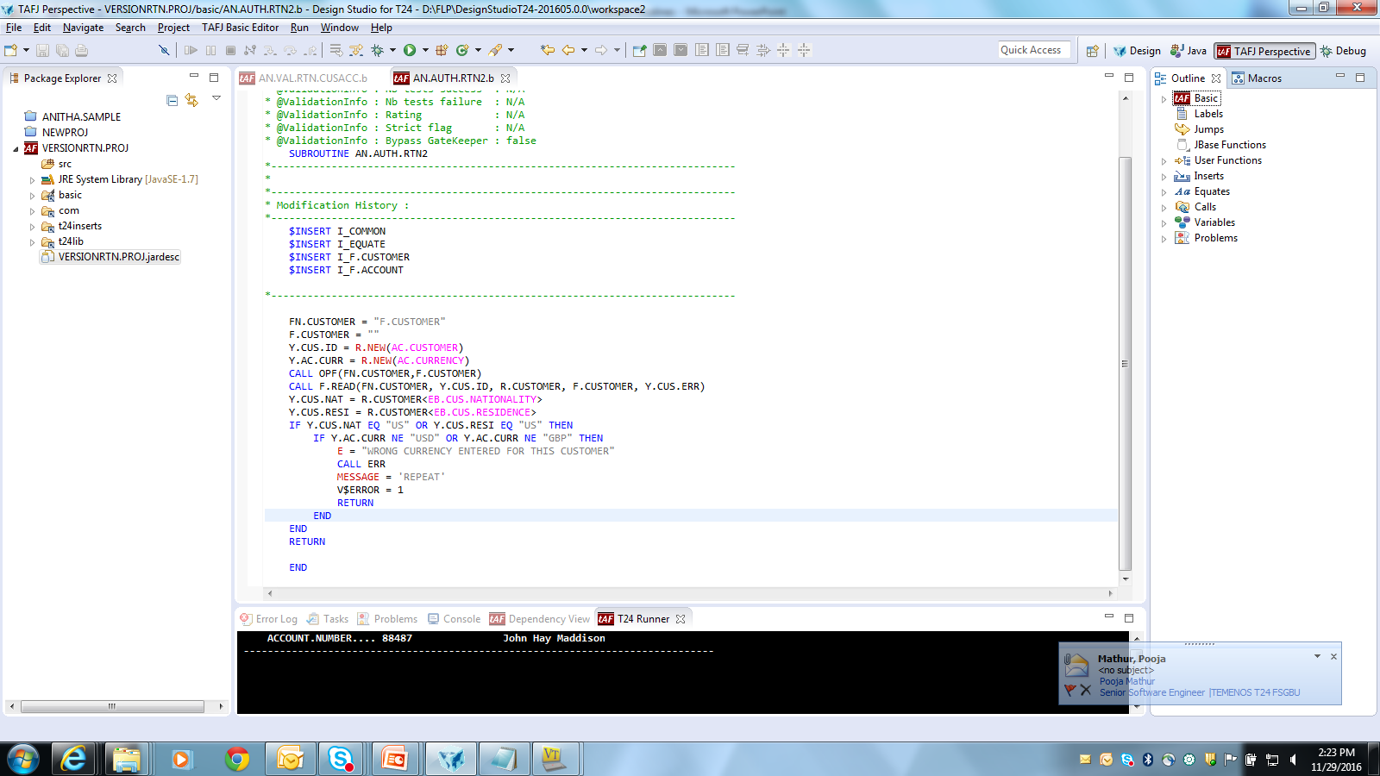
Solution

Slide 77
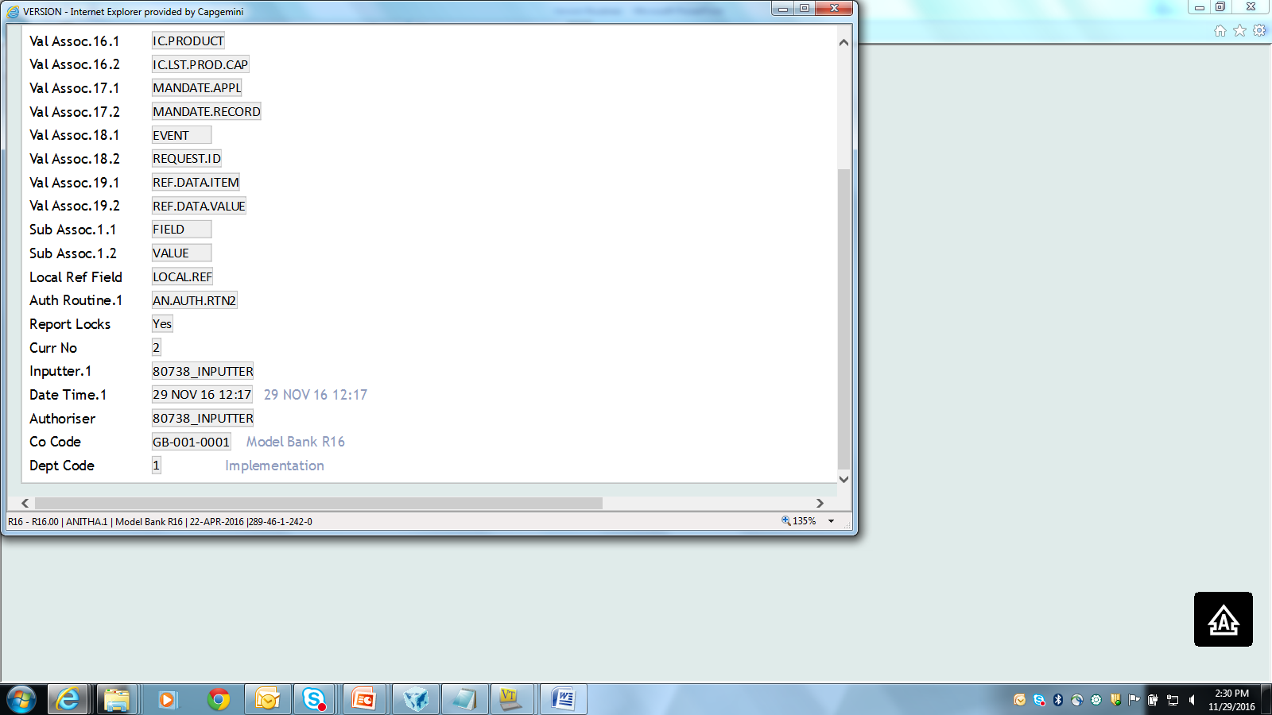
Attach the routine

Slide 78
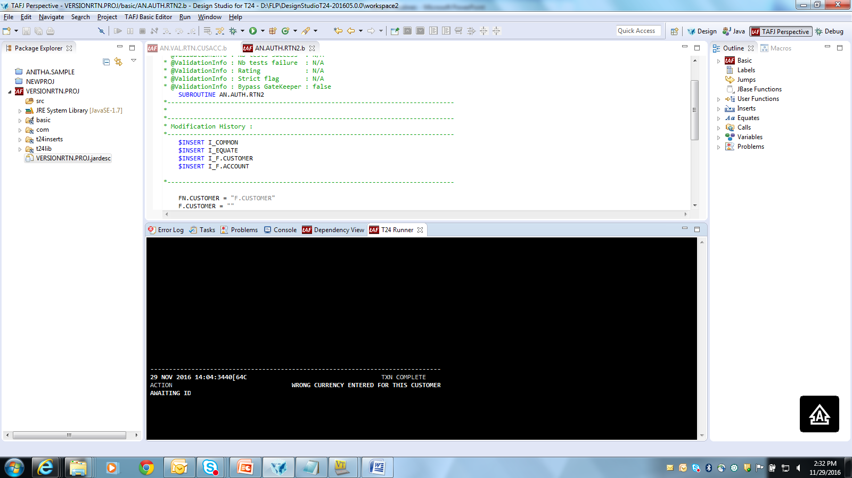
Authorise

Slide 79
Scenario
What happens if no of authorisers is two
First Authorisation will not call authorisation routine
Its called during Second authorisation

Slide 80
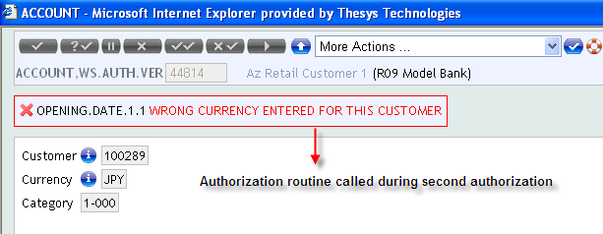
Second Authorisation

Slide 81

After First Authorisation

Slide 82

Error Handling
Should include Override-1 field in the Version
Notes:
Overrides are written in the override field of any application.
So when override is generated it expects for a override field, which is missing

Slide 83

Error Handling
Notes:
Second Authorisation is allowed only for some user. In the version if we give no of authorizers as two then
The user in which we go for the second authorisation should be given proper permission

Slide 84
Auto Field Routine
Why Auto field routine?
When auto field Routine is called?
Where do we Attach the routine?
Mandatory Prerequisites.
How to Create Auto field Routines – Scenario.

Slide 85
Why AutoField Routine
To perform any special editing to a record.
To modify the record as soon as id is fetched.

Slide 86
When Autofield Routine is called?
After id of the record is input.
After record is fetched
Before it is displayed.

Slide 87
Mandatory - Prerequisites
Entry in PGM.FILE
Entry in EB.API

Slide 88
Where do we Attach the routine
To the field Auto New Content

Slide 89
How to Attach routines- Scenario
Create a Version for Account which mandates the account officer to 1 if the sector is 1001 or else 2

Slide 90

Routine

Slide 91

Attach the Routine

Slide 92

Run the Version

Slide 93
Auto Field Routine
Create a local reference field for the ACCOUNT application called TOT.USD.ACC
Create a version for the ACCOUNT application . Fields to be part of the version are
All mandatory fields of the ACCOUNT application
Local reference field TOT.USD.ACC
The field TOT.USD.ACC will denote the total number of USD accounts created till date
Notes:
The stated task aims at teaching you the working principle of Auto Field Routine. The requirement for the task is as follows:
1. Create a local reference field for the ACCOUNT application called TOT.USD.ACC
2. Create a version for the ACCOUNT application . Fields to be part of the version are
2.1All mandatory fields of the ACCOUNT application
2.2 Local reference field TOT.USD.ACC
3. The field TOT.USD.ACC will denote the total number of USD accounts created till date

Slide 94
The Algorithm
Create a local reference field to display the total number of USD accounts
Create the version for the ACCOUNT application. Attach the local reference field to your version
Write the subroutine to calculate the total number of USD accounts and populate the value in the local reference field
Compile the routine and catalog the subroutine
Make an entry in EB.API
Attach the subroutine to the field ‘Aut New Content’ in the VERSION Application
Notes:
Now you will analyse the algorithm for the given task ,
STEP 1: Create a local reference field to display the total number of USD accounts
STEP 2: Create the version for the ACCOUNT application. Attach the local reference field to your version
STEP 3: Write the subroutine to calculate the total number of USD accounts and populate the value in the local reference field
STEP 4: Compile the routine and catalog the subroutine
STEP 5: For the subroutine , make an entry in EB.API
STEP 6 : Attach the subroutine to the field ‘Aut New Content’ in the VERSION Application
Now you will code the subroutine.

Slide 95

The subroutine
Notes:
Write the code for the subroutine. In the subroutine, a routine called GET.LOC.REF is invoked to get the field position of the local reference field. It is stored in the variable called LOC.POS. Parameters to be passed to this routine are 1) Application name 2) Local reference field name 3) the variable that will return the field position of the local reference field.
Then you execute a select statement to find out the total number of USD accounts using the EB.READLIST routine. The standard now is to use DAS instead of EB.READLIST which will be taught duringTemplate Programming . The result is stored in the parameter NO.OF.REC.
Finally the value in NO.OF.REC is returned to the local ref field. Compile and catalog the subroutine.

Slide 96
Workshop
Create an FT version which displays value date to be 1st January of the current year.

Slide 97
ID Routine
Why ID routine?
When ID Routine is called?
Where do we Attach the routine?
Mandatory Prerequisites.
How to Create ID Routines – Scenario.

Slide 98
Why ID Routine?
To manipulate the id of the record.

Slide 99
When is it called
As soon as id of the record is entered
Before fetching the Record

Slide 100
Where do we attach routine
In the version Application
Id routine field.

Slide 101
Mandatory Prerequisites
Entry in PGM.FILE
Entry in EB.API

Slide 102
How to attach the routine - Scenario
Create a version for the Enquiry application with all the mandatory fields
Create subroutine that will get executed as soon as the id of an enquiry is entered and prefixes the id of the enquiry with ‘THE.TRG’ provided it is not a %Enquiry or an Enquiry-List.

Slide 103

Routine
Notes:
TRG.ENQ.RTN

Slide 104

Create Version and attach routine
Notes:
TRG.ENQ.RTN

Slide 105

Run the version

Slide 106
WorkShop 1
Create a version for acct application when a new Account is created, check if the 3rd and last digit does not have the same no. if the nos. are same then increment the no. by one.

Slide 107

Routine

Slide 108
Attach the routine

Slide 109


Output

Slide 110
Check Record Routine
Check record routine is used to alter field attributes or to default values into fields
It is invoked after the id is entered and validated
Gets invoked when the functions I(Input), D(Delete), A(Authorise) and R(Reverse) are used
Attached to the field CHECK.REC.RTN of the version
Check record routines need to have an entry in EB.API
Notes:
You will now be introduced to Check record routine in T24.
Check record routine is used to alter field attributes or to default values into fields
This routine is called after the ID is entered and validated
Check record routine gets invoked when the functions I(Input), D(Delete), A(Authorise) and R(Reverse) are used.
This routine is attached to the field CHECK.REC.RTN of the version
Check record routines need to have an entry in EB.API

Slide 111
Check Record Routine
Create a version for the ACCOUNT application with all the mandatory fields
Using the version ,the user should be allowed to open only account records that belong to CATEGORY 6001. Write a subroutine to perform the validation
Notes:
The stated task teaches you about Check Record Routine in T24.
1. Create a version for the ACCOUNT application with all the mandatory fields
2. Using the version ,the user should be allowed to open only account records that belong to CATEGORY 6001. Write a subroutine to perform the validation

Slide 112
The Algorithm
Create the version for the ACCOUNT application
Check the id of the version that is opened currently by the user
User should be allowed to open only those accounts that belong to CATEGORY 6001
Notes:
Lets now design the algorithm for the given requirement,
STEP 1: Create the version for the ACCOUNT application
Step 2: Check the id of the version that is opened currently by the user
STEP 3: User should be allowed to open only those accounts that belong to CATEGORY 6001

Slide 113

Write the subroutine
Notes:
Remember the user should be allowed to open only those account records that belongs to CATEGORY 6001.The given subroutine validates the value of the CATEGORY field as required.
112

Slide 114
AfterUnauth routine
Why AfterUnauth routine?
When AfterUnauth Routine is called?
Where do we Attach the routine?
Mandatory Prerequisites.
How to Create AfterUnauth Routines – Scenario

Slide 115
Why AfterUnauth
To perform any operation after Input Routine
After Committing the record.
Without affecting the existing record

Slide 116
When is it called?
While Committing a new/existing record
After the record been written into the $NAU file.

Slide 117

Where do we attach routine

Slide 118
How do we attach- Scenario
When a transaction is committed using a version of the FT application, the user should be taken to another version in order to input the charges (if any).

Slide 119
Mandatory Prerequisites
Entry in PGM.FILE
Entry in EB.API

Slide 120
PGM.VERSION
Common variable
Defined in I_COMMON
Contains the name of the currently opened version.
Example : CUSTOMER,INPUT
APPLICATION : CUSTOMER
PGM.VERSION :,INPUT

Slide 121
INPUT.BUFFER
Common variable.
Defined in I_COMMON
Any input that a user wishes to execute from the command line.
Example
INPUT.BUFFER = C.U:”CUSTOMER I” : C.F
C.U : Ctrl U Enter -> will go to the command line
C.F : Ctrl F Enter(F3) -> Used to obtain a new id
Notes:
This is applicable only in the Classic Version

Slide 122
V$FUNCTION
Common variable.
Defined in I_COMMON
Contains the function that is being currently chosen by the user.

Slide 123

Routine – Reflection Mode

Slide 124


Attach the Routine

Slide 125

Execute the version – Reflection Mode

Slide 126

After Commit – Reflection Mode

Slide 127

Routine – Browser Mode

Slide 128


Attach the Routine

Slide 129

Execute the version

Slide 130

Commit

Slide 131
Workshop
Create a version for Account as soon as a new Account is created a teller version is called to deposit LCY amount

Slide 132
BeforeAuth Routine
Why BeforeAuth routine?
When BeforeAuth Routine is called?
Where do we Attach the routine?
Mandatory Prerequisites.
How to Create BeforeAuth Routines – Scenario

Slide 133
Why Before Auth
To Perform Any operation after Commit
To perform Operation before Authorise

Slide 134
When BeforeAuth is called?
During authorization of an INAU record.
Called before Version Auth routine is executed.
Before.Auth – Before F.WRITE.
Changes made to R.NEW will reflect in the record written
AUTH routine – After F.WRITE

Slide 135

Where to Attach the Routine?
BeforeAuth Rtn.1 field of the Version

Slide 136
Mandatory Prerequisites
Entry in PGM.FILE
Entry in EB.API

Slide 137
How to Attach Routines - Scenario
While authorizing a customer record, the user should be given the option to fill in any special comments with the customer record like “Special Customer”.
Write a routine that will prompt the user to enter free text while authorizing a customer record.
Once the text is entered by the user, the data needs to be updated in the field TEXT in the Customer application.
If no text is entered by the user then the message “No text entered. Proceeding with other processing” should be displayed and the record should get authorized.

Slide 138

Routine

Slide 139


Attach the routine

Slide 140

Attach the routine

Slide 141
Workshop
Write a routine for an FT version such that
if the debit Currency is a foreign currency then debit amount is converted to local currency equivalent
and currency should be changed to local currency.

Slide 142


www.capgemini.com/financialservices

